Slide 1
A Labeling, Learning and Visualization Tool for Brain Imagery
BBM 479 / 480 Design Project
Desmin Alpaslan - 21945795
Vedat Baday - 21945867

Slide 2
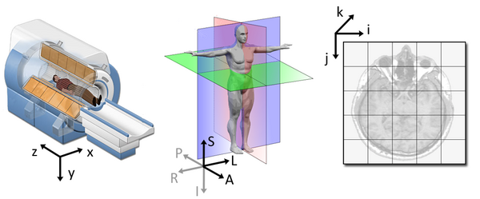
Field: 3D Brain Imaging & Surgery
Advanced technology in brain imaging (MRI, CT)
Surgical interventions for brain-related conditions
Intersection of medical and technological advancements
Promotes better patient outcomes and surgical precision
Continuous improvement in neurosurgical practices

Slide 3
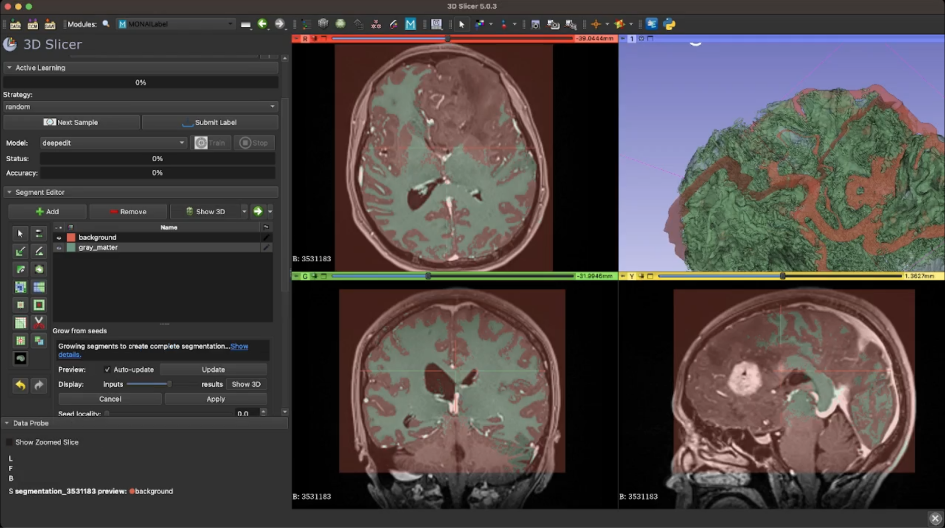
Problem: Manual Brain Segmentation
Time-consuming and labor-intensive process
Prone to human errors and inconsistencies
Limited scalability for large datasets
Hinders efficient surgical planning and decision-making
Stakeholder: First annotation session took months with a help of an expert, decreased to days after practice.

Slide 4
Solution: Automated Segmentation using Deep Learning
Leveraging neural networks for accurate and efficient brain segmentation
Reduced manual intervention and time requirements
Decreased from days to seconds!
Scalable for large datasets
Enables advanced surgical planning and analysis
Improving segmentation accuracy and consistency

Slide 5
Impact: Enhanced Surgical Planning
Precise identification of brain regions for surgical planning
Improved understanding of patient-specific anatomy
Enhanced visualization of critical structures with Virtual Reality (VR)
Minimized risk during surgical procedures
Optimized treatment strategies for better patient outcomes

Slide 6
Models - mmFormer
mmFormer model specializes in predicting the tumour region with or without the modalities!
What are modalities? T1, T1 contrast, T2, Flair etc. Each of those modalities contribute a different property to the model, but it is often hard to gather all kind of modalities for single patient.
So how did it perform in our dataset?
We split the our data (189 samples, with 6 t1, 1 t2 and 182 t1c) into 169 training and 20 validation sets. We fine tuned the pre-trained mmFormer model on our training set and then evaluated it.
 | Train DICE | Validation DICE
mmFormer Wout FineTune | 0.34 | 0.17
mmFormer With FineTune | 0.65 | 0.44

Slide 7
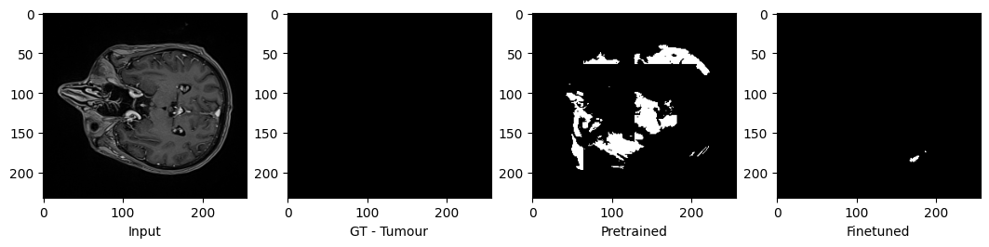
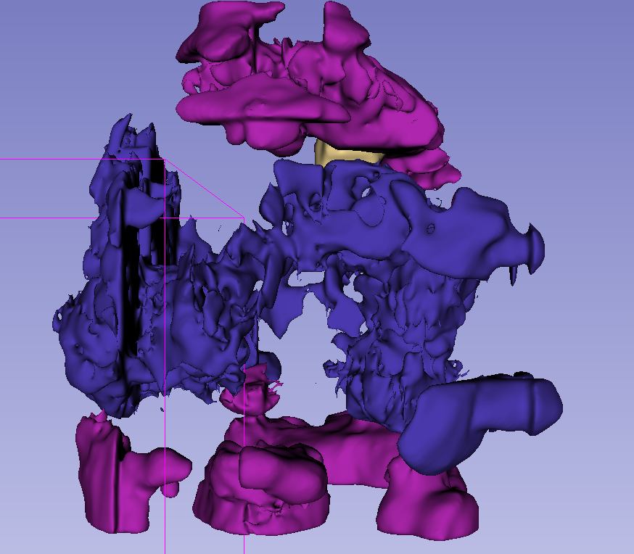
Models – mmFormer

Slide 8
Models - SwineUNETR
 | Train DICE | Validation DICE
SwineUNETR | 0.11 | 0.02

Slide 9
Future
Collaborate for broader dataset and insights
Assess performance in diverse populations
Gather feedback for ongoing algorithm refinement
Continuously refine models for accuracy
Explore cutting-edge techniques for enhanced accuracy

